Slide 1




St Paul’s School Vision
Our School Vision
For with you is the Fountain of life; in your light we see light. (Psalm 36 vs 9)
Inspired by God's love for us, we illuminate the goodness in others, we care for and protect His children and reach out to help other flourish in their journey to the fullness of life.
But what does this mean to us?

Slide 2


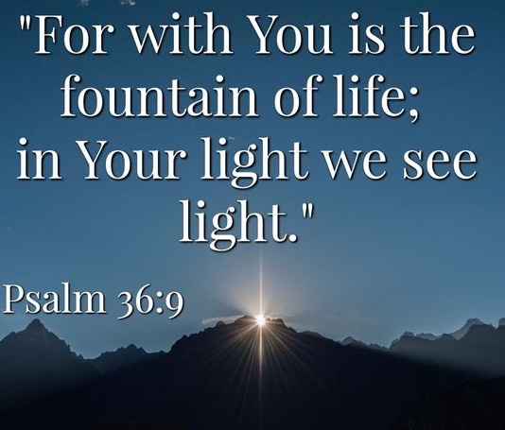

We illuminate His world
A song based on the St Paul’s School Vision Statement

Slide 3
Your light in me shines for all to see;
Your light in me will shine eternally.
For with you is the fountain of life;
In your light we see light.
Together we
journey to the fullness of life.

Slide 4
Inspired by God’s love for us,
We care for all around.
We reach out to help
all those in need,
Wherever they are found (they are found).

Slide 5
Your light in me shines for all to see;
Your light in me will shine eternally.
For with you is the fountain of life;
In your light we see light.
Together we
journey to the fullness of life.

Slide 6
Inspired by God’s love for us,
We flourish in his care.
We protect our friends
and do our best
to find goodness everywhere.
(It’s everywhere).

Slide 7
Your light in me shines for all to see;
Your light in me will shine eternally.
For with you is the fountain of life;
In your light we see light.
Together we
journey to the fullness of life.
Jesus, Light of the World, you're everything to me, (x3)
Illuminate your goodness all around through me.

